Slide 1
Presentation on
CD Audio
CD ROM
Extended Architecture

Slide 2
Introduction
CD Audio
A music CD that can be played in any standard CD player.
Music is stored on Audio CDs as uncompressed digital data.
CD ROM
Stands for Compact Disk Read Only Memory.
CD that can be read by a computer with an optical drive.
Extended Architecture
Modification of CD-ROM.
Provide better video and audio playback functionality from a disc.

Slide 3
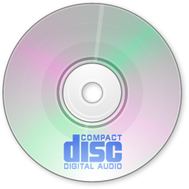
CD audio

Slide 4
CD audio
No data is lost and quality is very high.
Not possible to copy a track from an Audio CD.
But can be copied using ripping tools.
Different than Data CD.
Audio CD format is typically referred to as a CDA file (.cda).
Converting a 44.1 kHz WAV file to CDA introduces no noise, distortion or coloration to the sound.
Uses a sample rate of 44.1 kHz for stereo audio.

Slide 5

Cd rom

Slide 6
CD rom
The "ROM" part of the term means the data on the disc is "read-only," or cannot be altered or erased.
Can hold up to 700 MB.
Disks are made from a 1.2 mm thick disk of polycarbonate plastic, with a thin layer of aluminum to make a reflecting surface.
common size is 120 mm.
CD-ROMs share the same technology as audio CDs, but they are formatted differently.
Can store many types of data.(audio, video, images, documents, etc.)

Slide 7
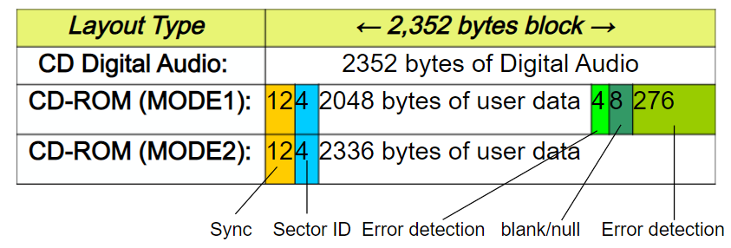
Cd-rom formats
A CD-ROM sector contains 2352 bytes, divided into 98 24-byte frames.

Slide 8
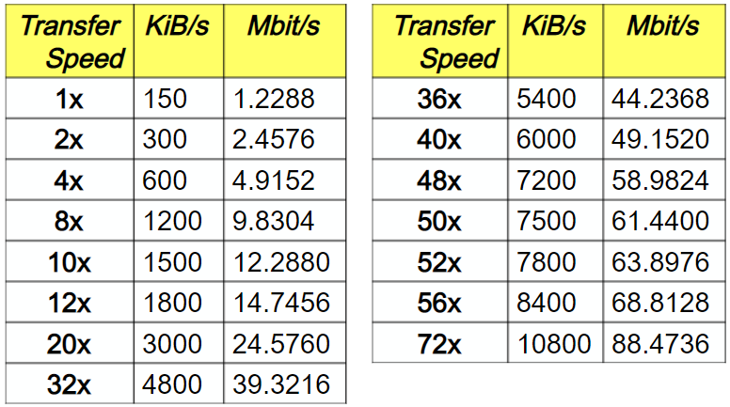
Data transfer speeds

Slide 9
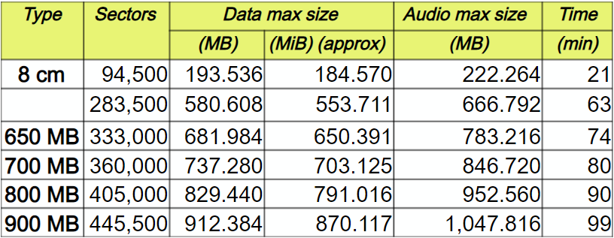
Cd capacity
Note : 90 and 99 minute discs are not standard

Slide 10
CD-ROM extended architecture
Developed jointly by Sony, Philips and Microsoft in 1989.
Defines two new types of sectors that enable it to read and display data, graphics, video, and audio at the same time.
Uses CD-ROM mode 2 to define actual blocks.
Two forms.
Form 1
Improved error handling.
Form 2
Used for compressed audio, video or picture.

Slide 11
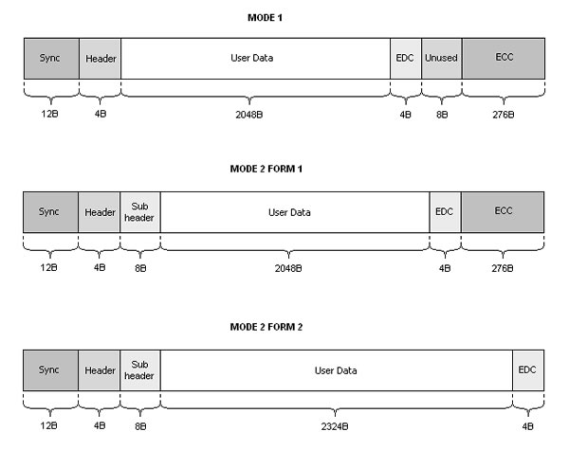
Cd-rom/xa Formats

Slide 12
Thank you !!!

